Slide 1
Climate Intelligence
Harnessing OGC building blocks towards climate change resilience
Nils Hempelmann
Open Geospatial Consortium

Slide 2
https://www.ogc.org/ogc/innovation
Innovation Program

Slide 3
Technology Readiness Levels
Design
Experiment
Testbed
Sprint
Engineering
Services
IE
Plugfest
Pilot
Operational
Exercise
Notes:
OGC IP covers the levels 2-8

Slide 4
OGC Climate Resilience Domain Working Group
Findable
Provide a forum for discussion and documentation of interoperability requirements for a given information or user community;
Scope of this DWG is broad, it will emphasise certain key activities:
Issues that impact climate resilience information systems, their technology and markets.
Define the business issues and approaches for OGC to incorporate so that climate action considerations are brought into proper focus.
Define approaches for engaging with the leading climate resilience information providers to enlist their support.
Accessible
Interoperable
Reusable
Chair:

Slide 5
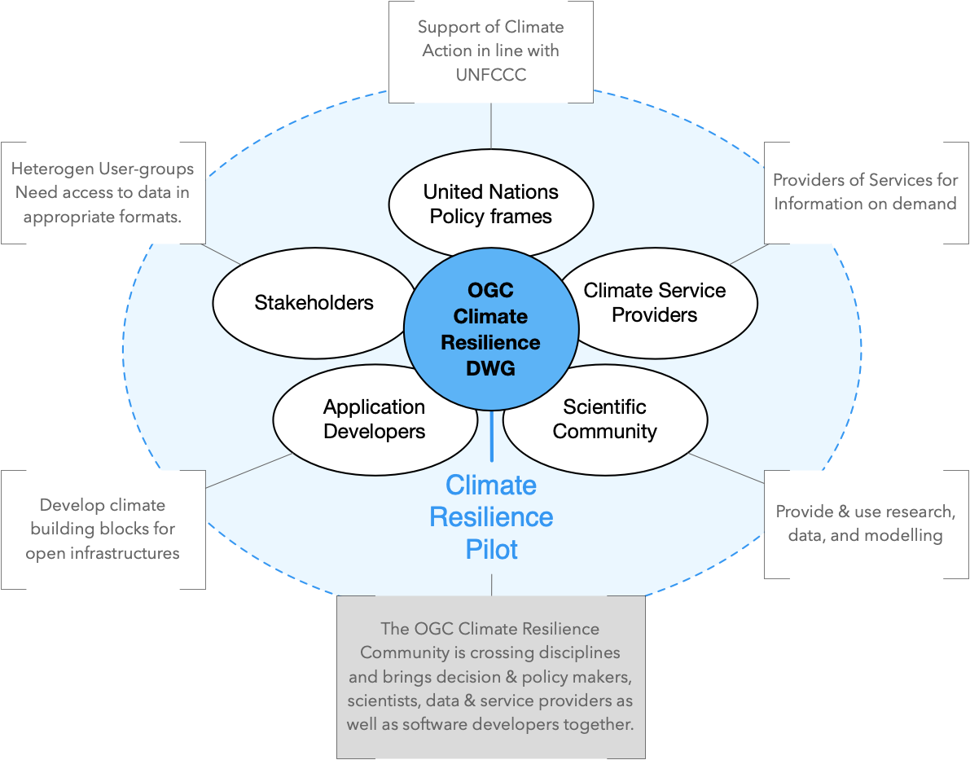
OGC Climate Resilience Community

Slide 6
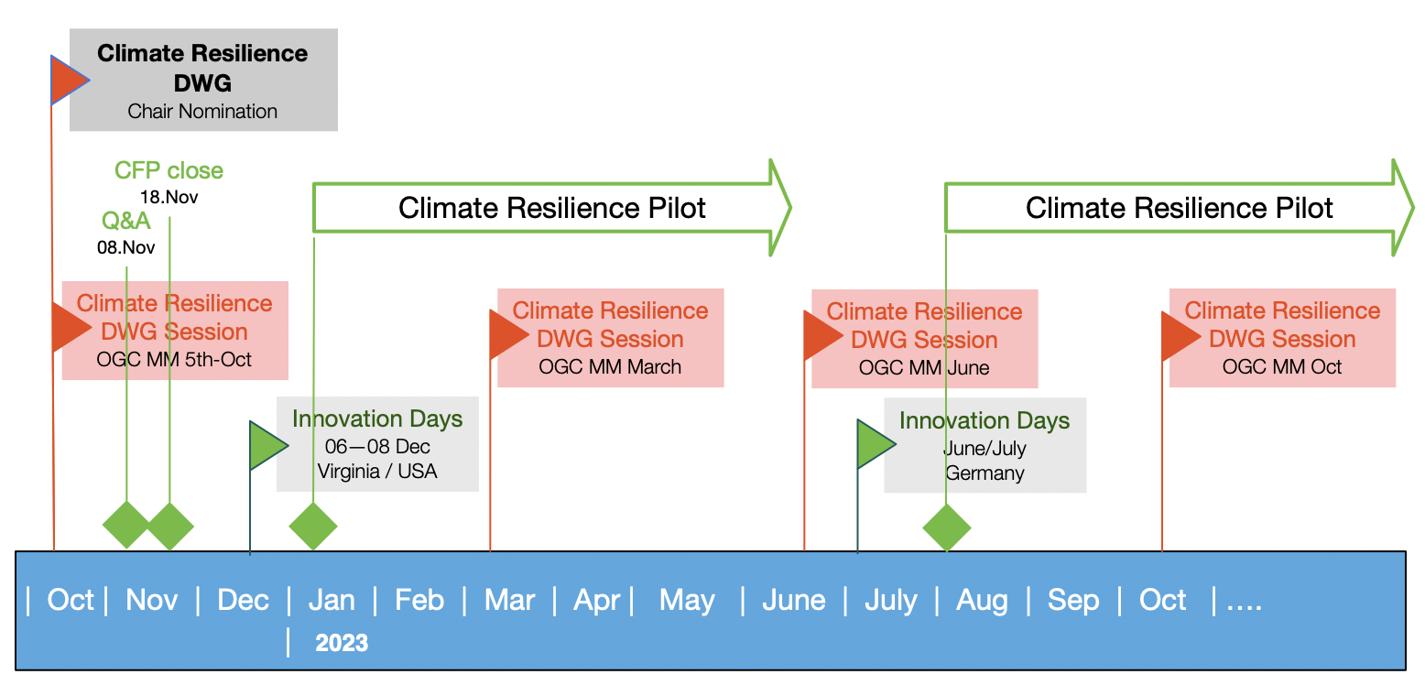
Climate Resilience Pilots

Slide 7
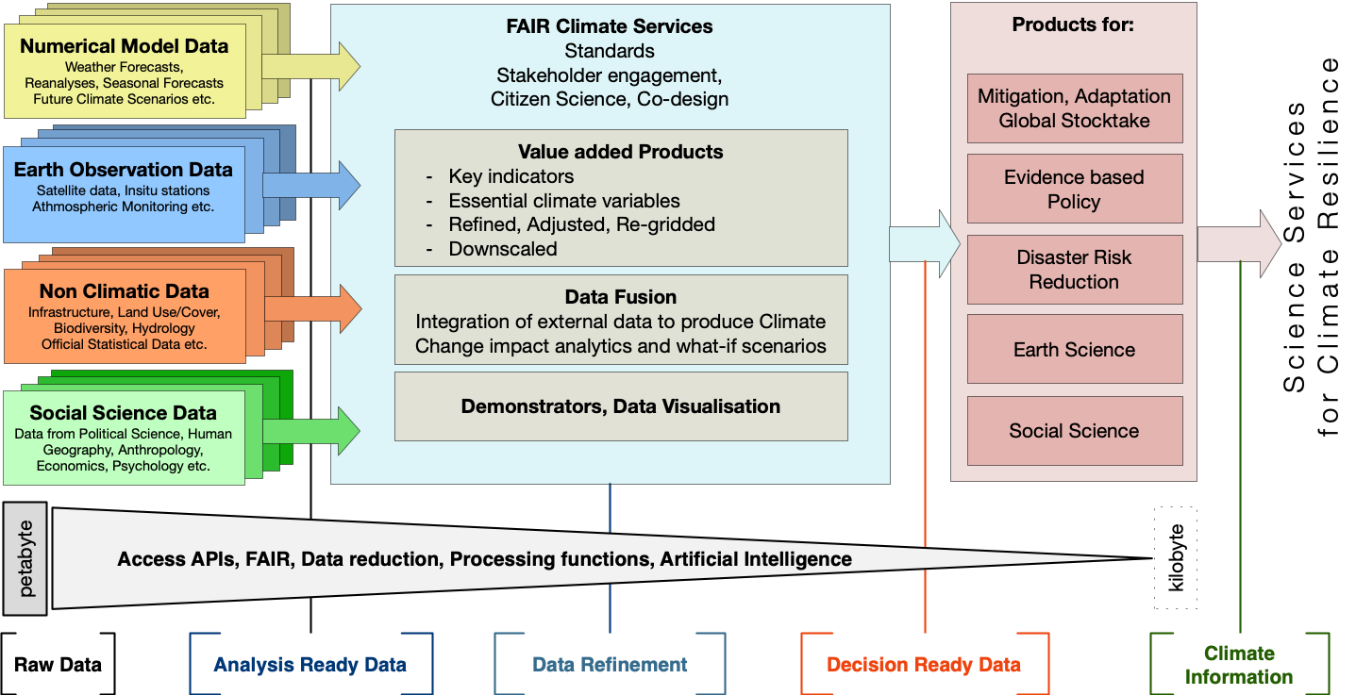
Climate and Disaster Resilience information Systems

Slide 8
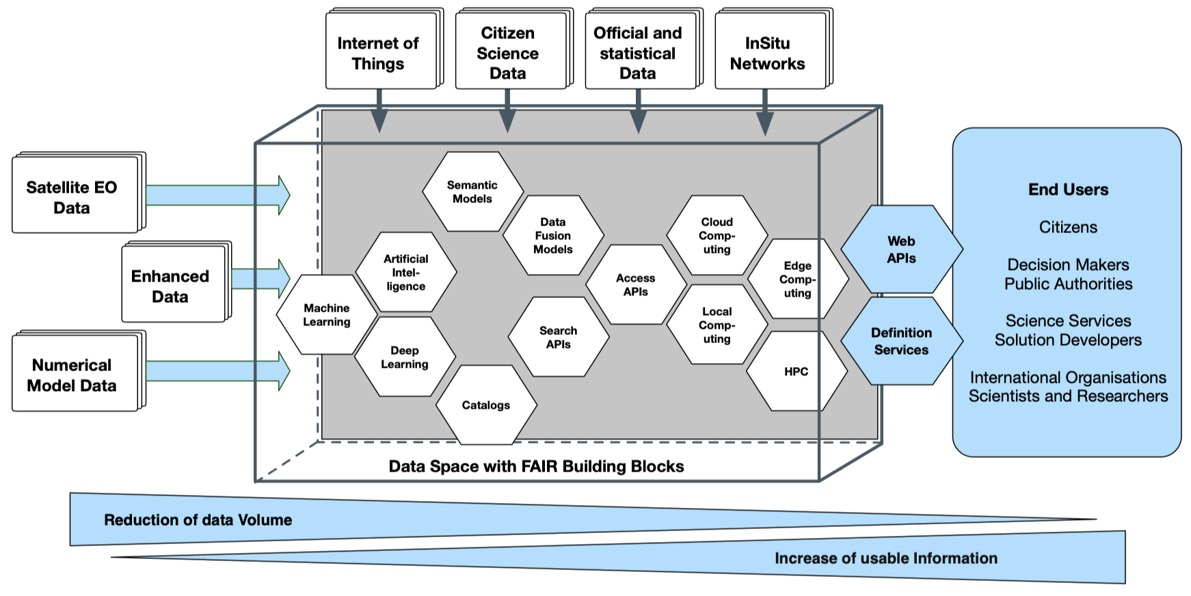
FAIR Climate Service

Slide 9
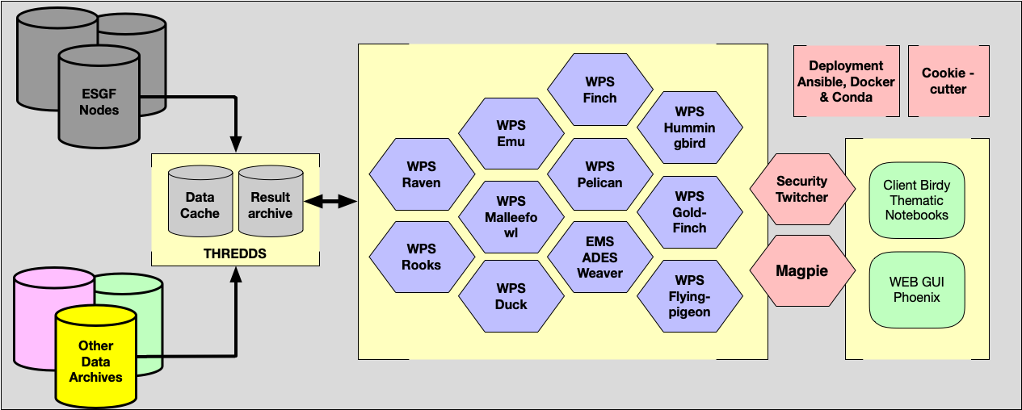
Building Blocks for
Climate Resilience Information Systems (CRIS)

Slide 10
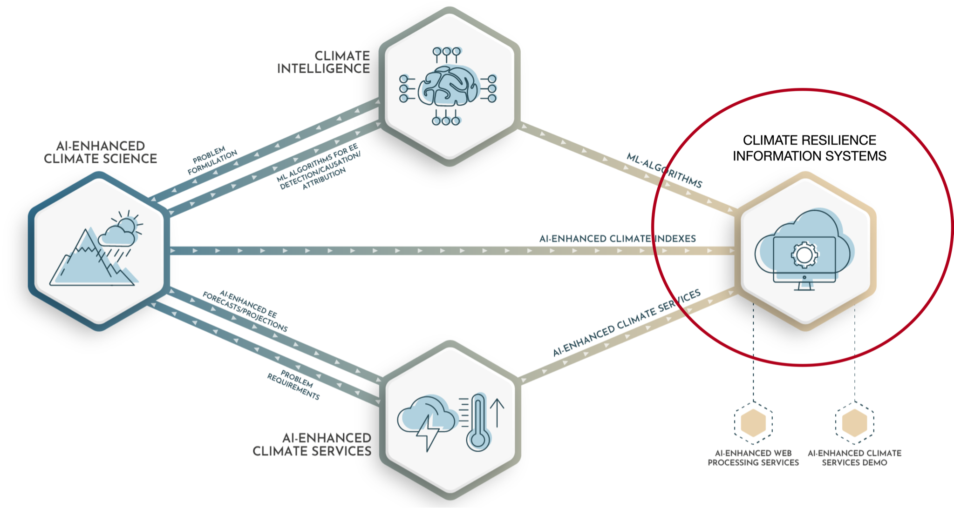
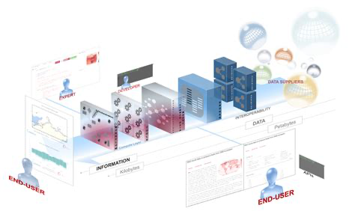
AI-Enhanced Climate Resilience Information Systems
Climate Building block
OGC API Processes based
https://climateintelligence.eu

Slide 11
Inpainting of missing values
Prototype:
https://clint.dkrz.de
Copernicus
Ready
Prototypes
Ground Truth
GT with HadEX mask
AI infilled
Plesiat et al. 2022 (in prep.)
climateintelligence.eu

Slide 12
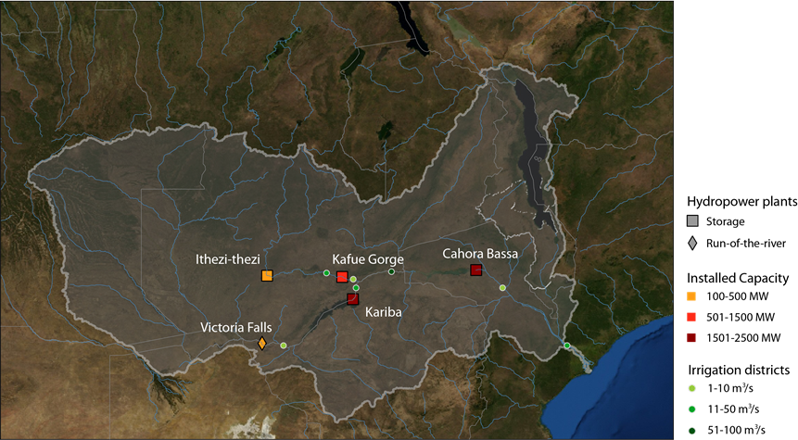
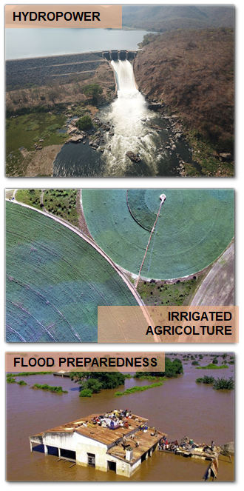
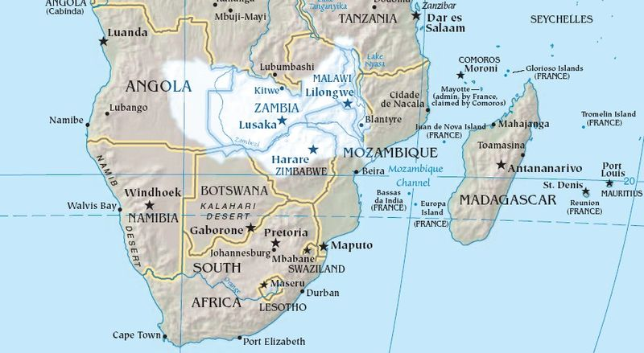
The ZAMBEZI RIVER BASIN
Watercourse Length: 2750 km
Catchment Area: 1.39 M km²
Population: ~40 million inhabitants
Notes:
Transboundary River Basin shared by 8 Countries: (i) Zambia 41%; (ii) Angola 18%; (iii) Zimbabwe 16%; (iv) Mozambique 11%; (v-viii) Malawi 8%, Botswana, Tanzania, Namibia 6%.
The ZW has a vital role in ensuring food security in the region due to its role in sustaining agriculture and fisheries. The existing irrigated areas cover about 182,000 ha. The high runoff in the upper part of the ZRB combined with a fall of more than 1000 m along the river course to the ocean provides a good opportunity for hydropower production, which is currently exploited by an installed capacity of 5.5 GW that represents the main source of electricity within the basin. Around 70% of this installed capacity is concentrated in two mega-dams, namely Kariba and Cahora Bassa. Two other dams, Ithezi-thezi and Kafue Gorge, are instead located in Zambia on the tributary Kafue River and contribute an additional installed capacity of 1.1 GW.
New dams in the basin are planned for the next decades to respond to both hydropower and agricultural capacity expansion.

Slide 13
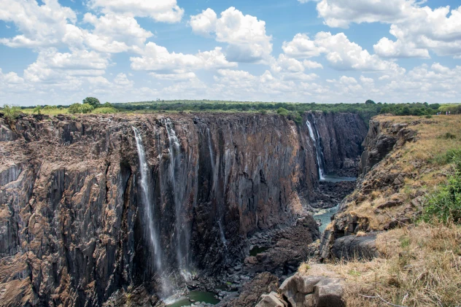
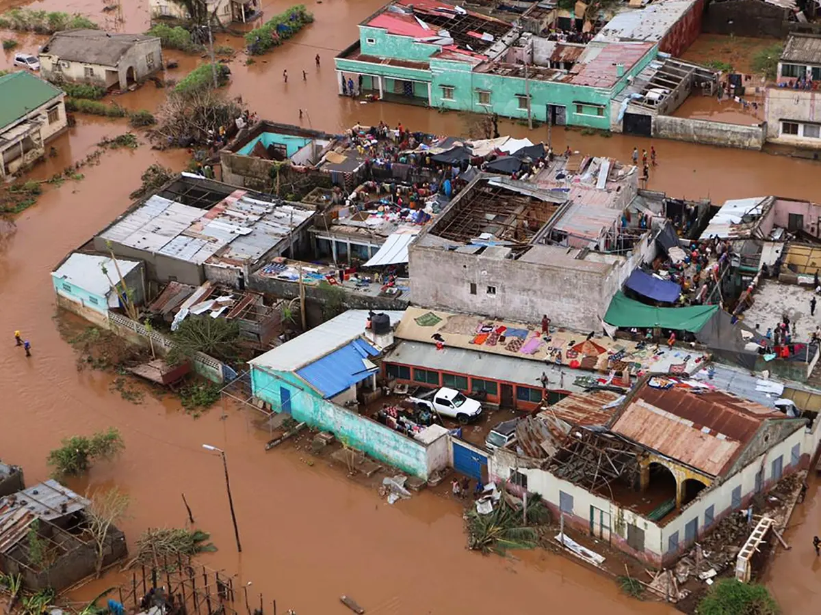
EXTREME EVENTS
Victoria Falls after historic drought
Source: AccuWeather (2020)
Flooding in Mozambique from Tropical Cyclone Idai
Source: The Guardian (2019)
Notes:
The Zambezi region is vulnerable to recurrent droughts that result in poor harvests and loss of livestock, food insecurity and loss of life, damages to infrastructures and loss in hydropower production, leading to large economic losses, the spread of water-borne diseases and epidemics. For example, during the severe 1991/92 drought, the loss in hydropower generation from the Kariba dam resulted in an estimated US$102 million reduction in Gross Domestic Product in Zimbabwe.
The downstream parts of the ZRB are particularly exposed and vulnerable to tropical cyclones and related floods, as demonstrated by the recent devastating impacts of Cyclone Idai in 2019, which resulted in an estimated 1.85 million people in need of humanitarian assistance and protection, and in more than 1,000 fatalities over three countries (Mozambique, Malawi and Zimbabwe)

Slide 14
Models available
Hydrological models
Catchment model (HBV)
Distributed model (LISFLOOD)
Global operational forecasting systems (GloFAS & HYPE)
Reservoir operation model & hydropower/crop production
Notes:
Reservoir operation simulation/optimization model from previous proejcts

Slide 15
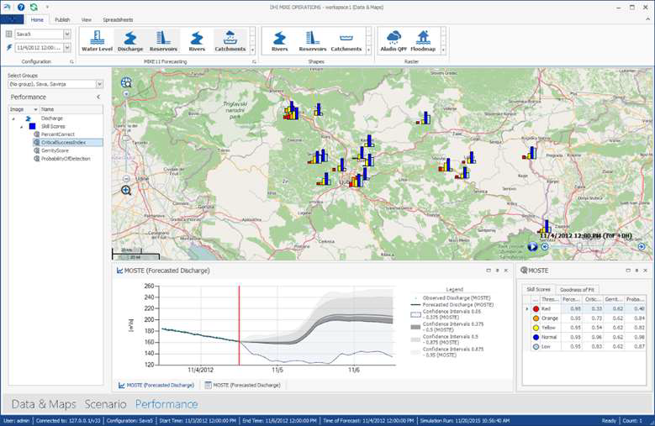
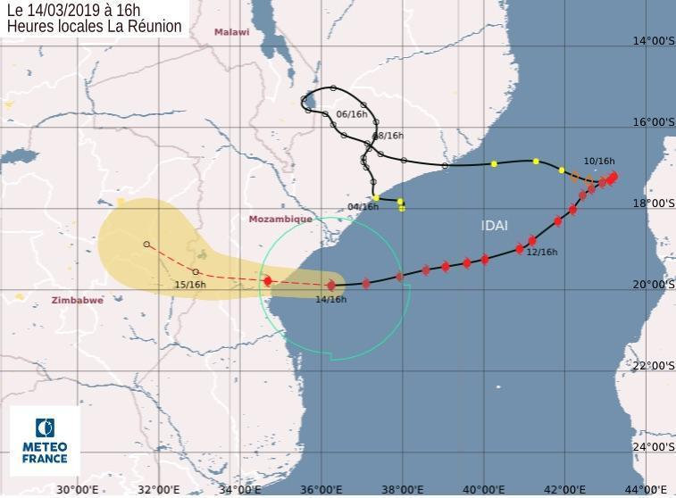
Climate Resilience Information Systems
Example of hydrological forecast from ZAMWIS (Zambezi Water Resources Information System) software interface
[Source: ZAMCOM]
Example of TC graphical warning issued by Météo-France one day before Cyclone Idai’s landfall in Mozambique (14 March 2019)
[Source: Météo-France La Réunion]
Notes:
ZAMCOM is currently using and developing a data and information system with a hydrological forecasting component called ZAMWIS (Zambezi Water Resources Information System)

Slide 16
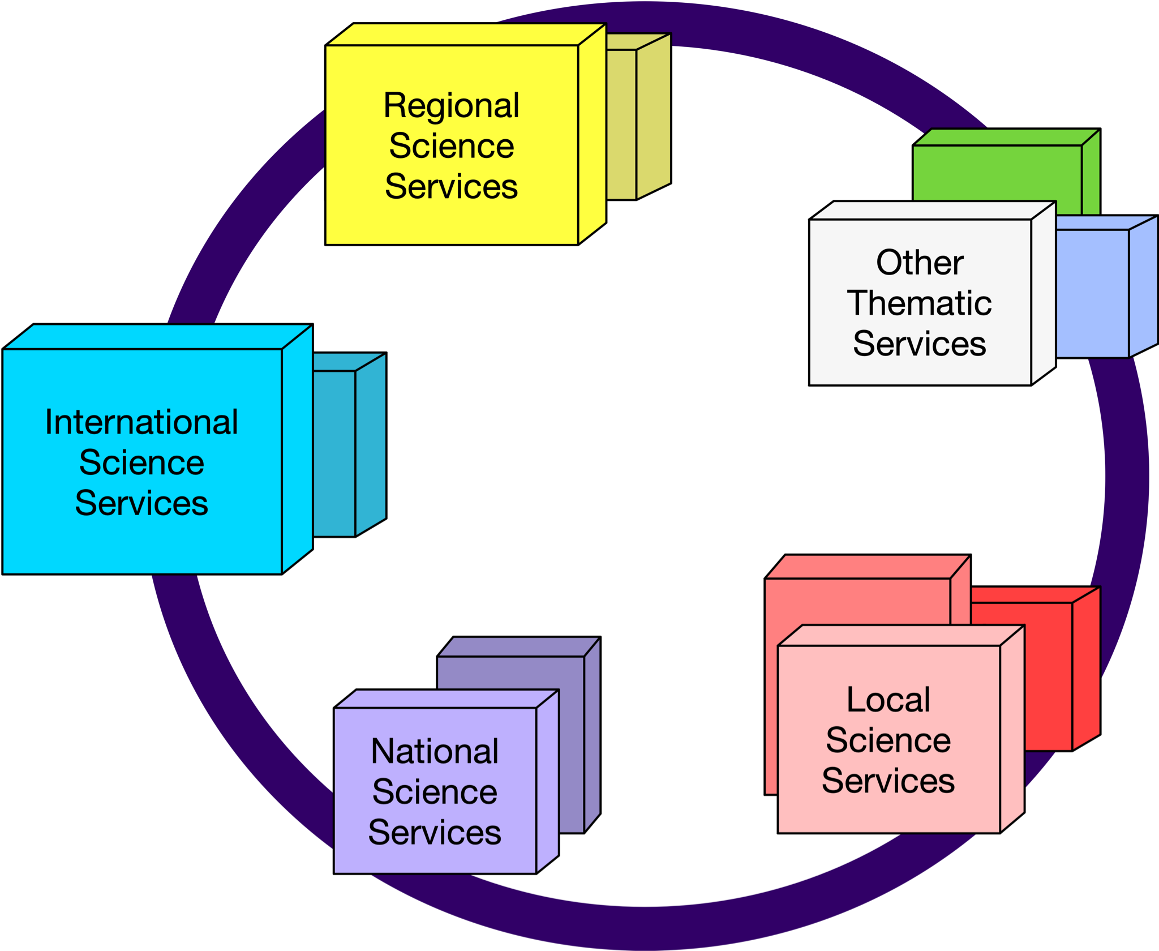
FAIR Climate Services
Importance of findable accessible interoperable and reusable Services

Slide 17
Guidelines Climate Resilience Information systems

Slide 18
Thank You
Community
Contact:
nhempelmann@ogc.org

Slide 19
Thank you
Questions?

